Slide 1

Fault localization ON PARALLEL PROGRAMMING
Supervised By:
Prof- M.T.U. Haider
Group no 21
Contribution by-
Chirag Setia 2006168
Alvin Prateek Ekka 2006158
Anshu Kumari 2006039

Slide 2
INTRODUCTION-
Fault localization is a critical task in software debugging, as it helps developers to isolate the root cause of a problem and fix it quickly.
- Lingming Zhang

Slide 3
Different Types of fault localization
Spectrum-based fault localization (SBFL) -utilizing test coverage information
Mutation-based fault localization (MBFL) -utilizing test results from mutating the program
Dynamic program slicing -utilizing dynamic program dependencies
Stack trace analysis -utilizing crash reports
Predicate switching -utilizing test results from mutating the results of conditional expressions
Information-retrieval based fault localization -utilizing bug report information
History-based fault localization -utilizing the development history
An Empirical Study of Fault Localization Families and Their Combinations. Daming Zou,

Slide 4
Our scope
two of the seven families that we chose
-Spectrum based fault localization
-Genetic based algorithm
We have to find correlation between the two techniques,to make a automated tool for fault localization tool.

Slide 5
Motivation of our Work-
Motivation behind this project is indeed what’s a very basic need in our daily lives.
-finding out the bugs out there in the software's as soon as possible.
-we don’t have to perform the code coverage manually to localize the tool.

Slide 6
Tools Used to make this project happen
Eclipse IDE(To run the project)
Jacoco tool(to run coverage test)
Junit test framework(to provide frame work for testing environment)

Slide 7
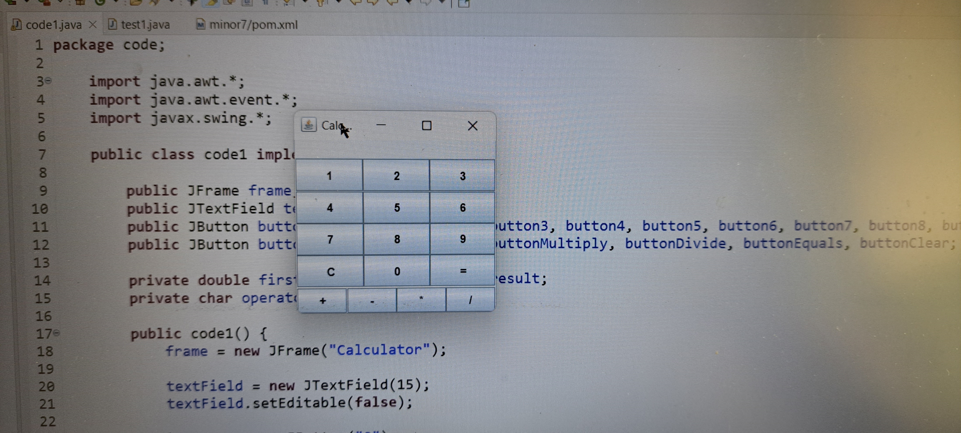
About My Project
https://www.geeksforgeeks.org/java-swing-simple-calculator/

Slide 8
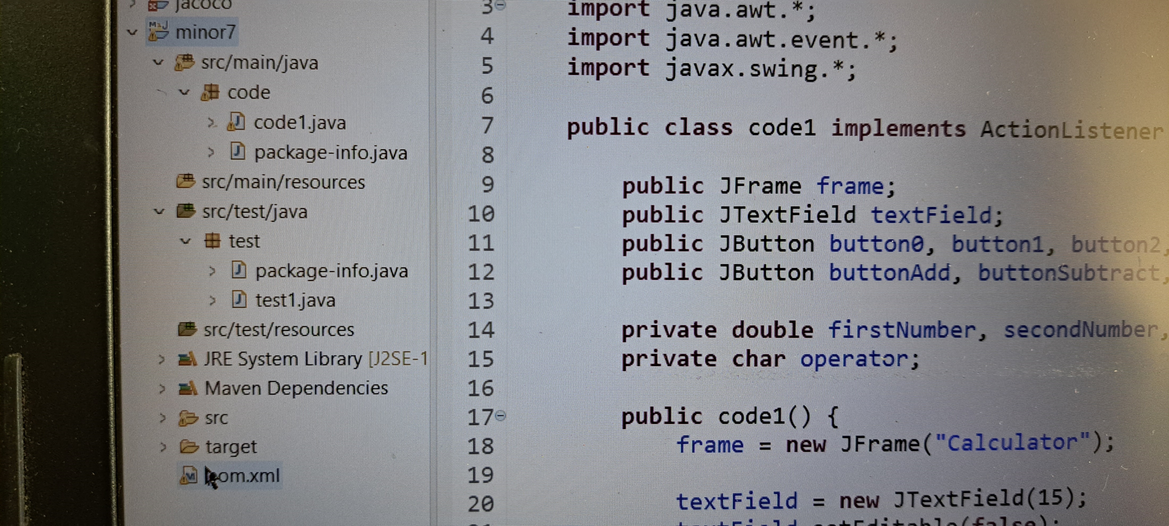
Removing the Bias in our project
So we took Reference code from the internet(code1)
Made test cases on our own(test1)
Made pom file own our own(minor7/pom.xml)

Slide 9
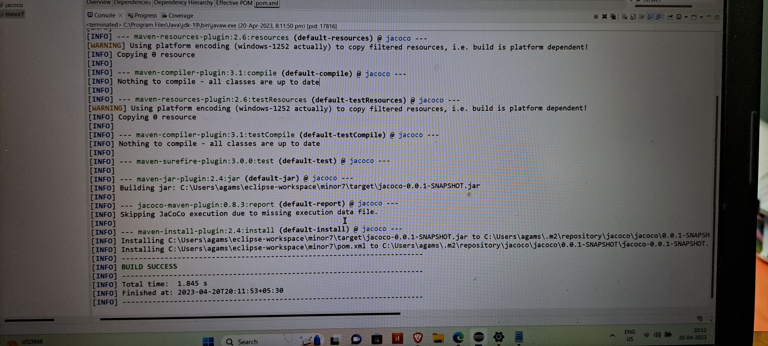
Building the project from scratch

Slide 10
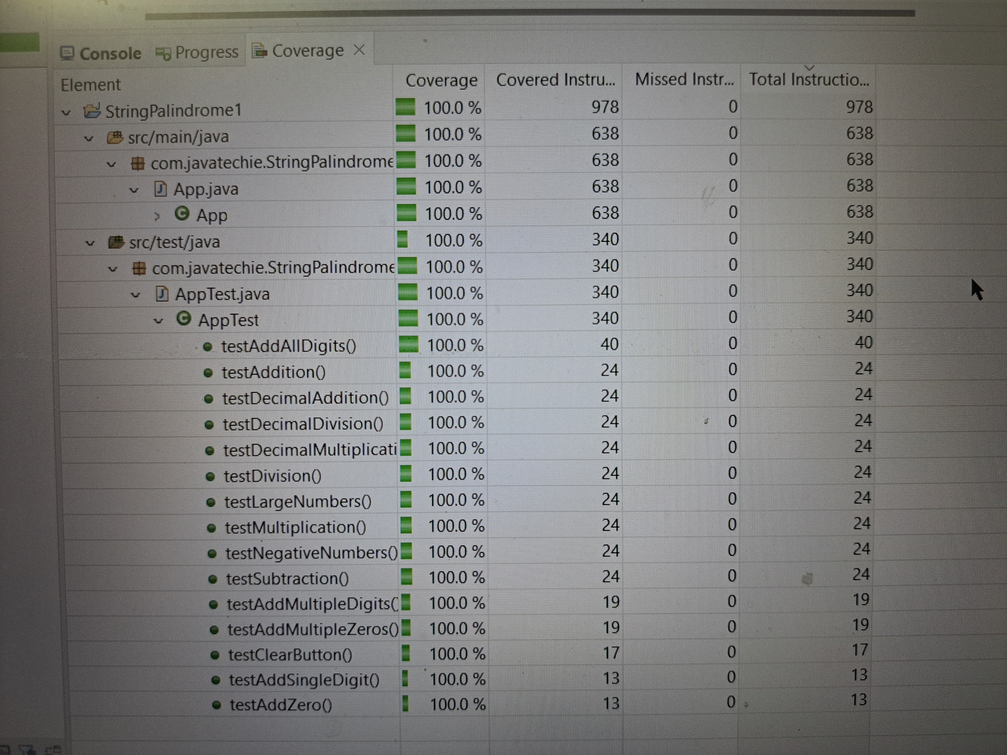
Code coverage of spectrum based fault localization.

Slide 11
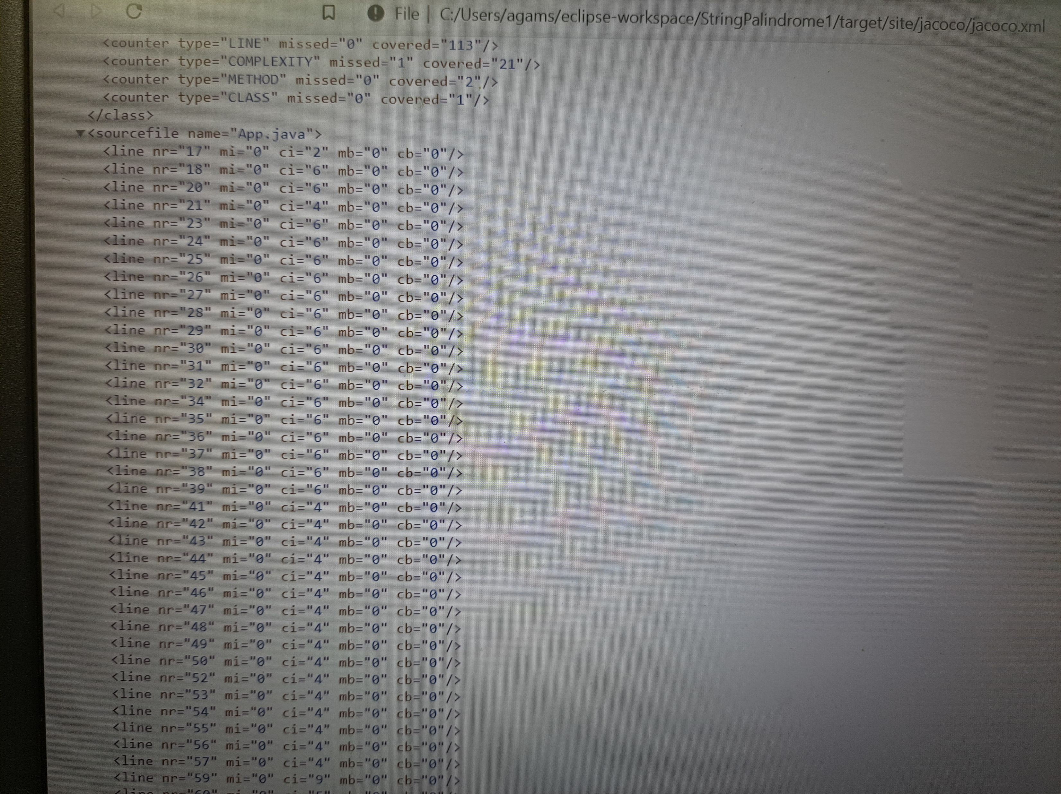
Detailed Report of the code Coverage

Slide 12
Mutation score of my mutations
Number of killed mutants :4
Total number of mutants:5
Mutation score =
(Number of killed mutants / Total number of mutants) x 100%
Mutation Score=80%

Slide 13
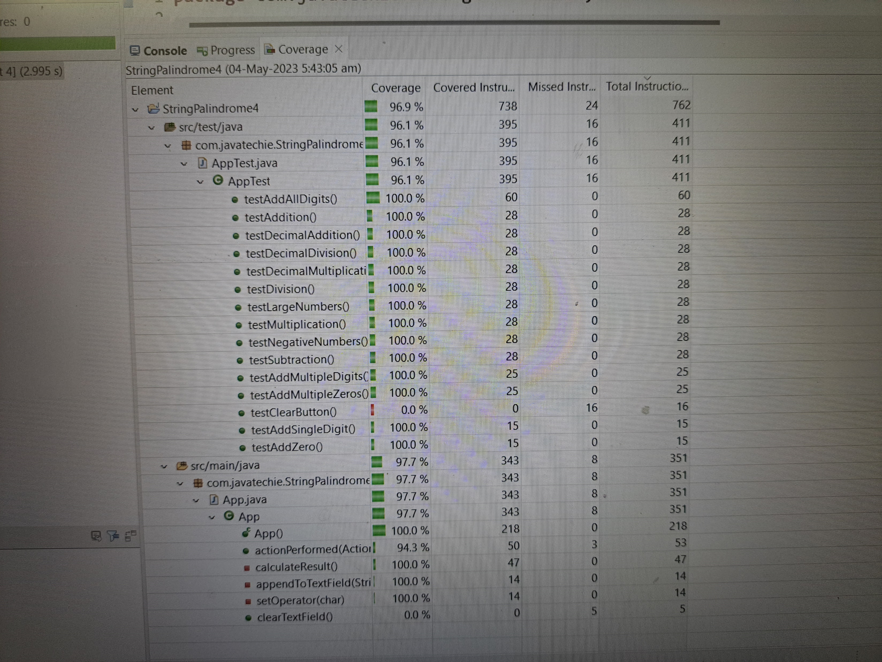
Code coverage of Genetic based fault localization

Slide 14
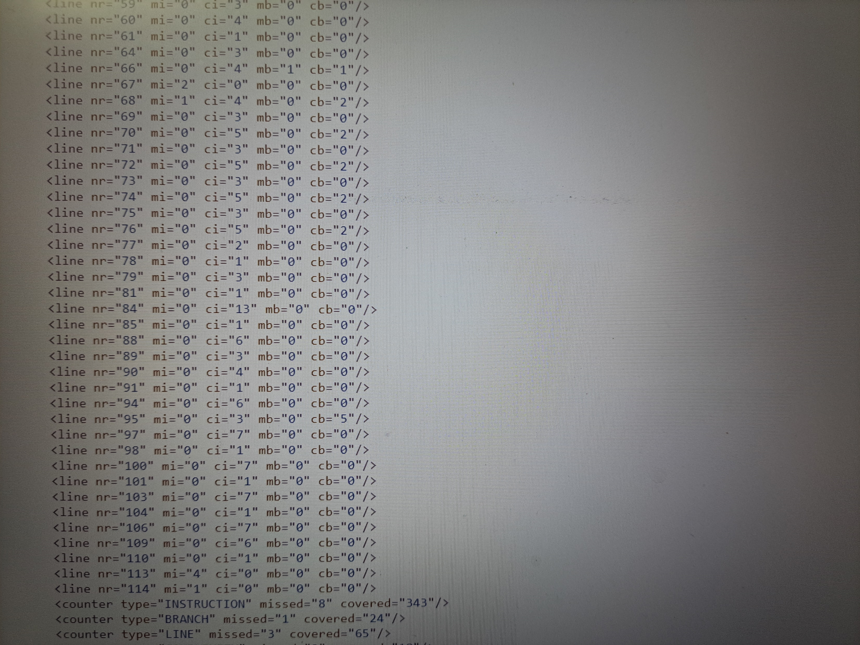
Detailed Report of the code Coverage

Slide 15
Method we used to find suspiciousness
mi (Missed Instructions)
ci (Covered Instructions)
mb (Missed Branches)
cb (Covered Branches)
Tarantula formula:
suspiciousness = cb / (cb + mb) / (cb / (cb + mb) + ci / (ci + mi))

Slide 16
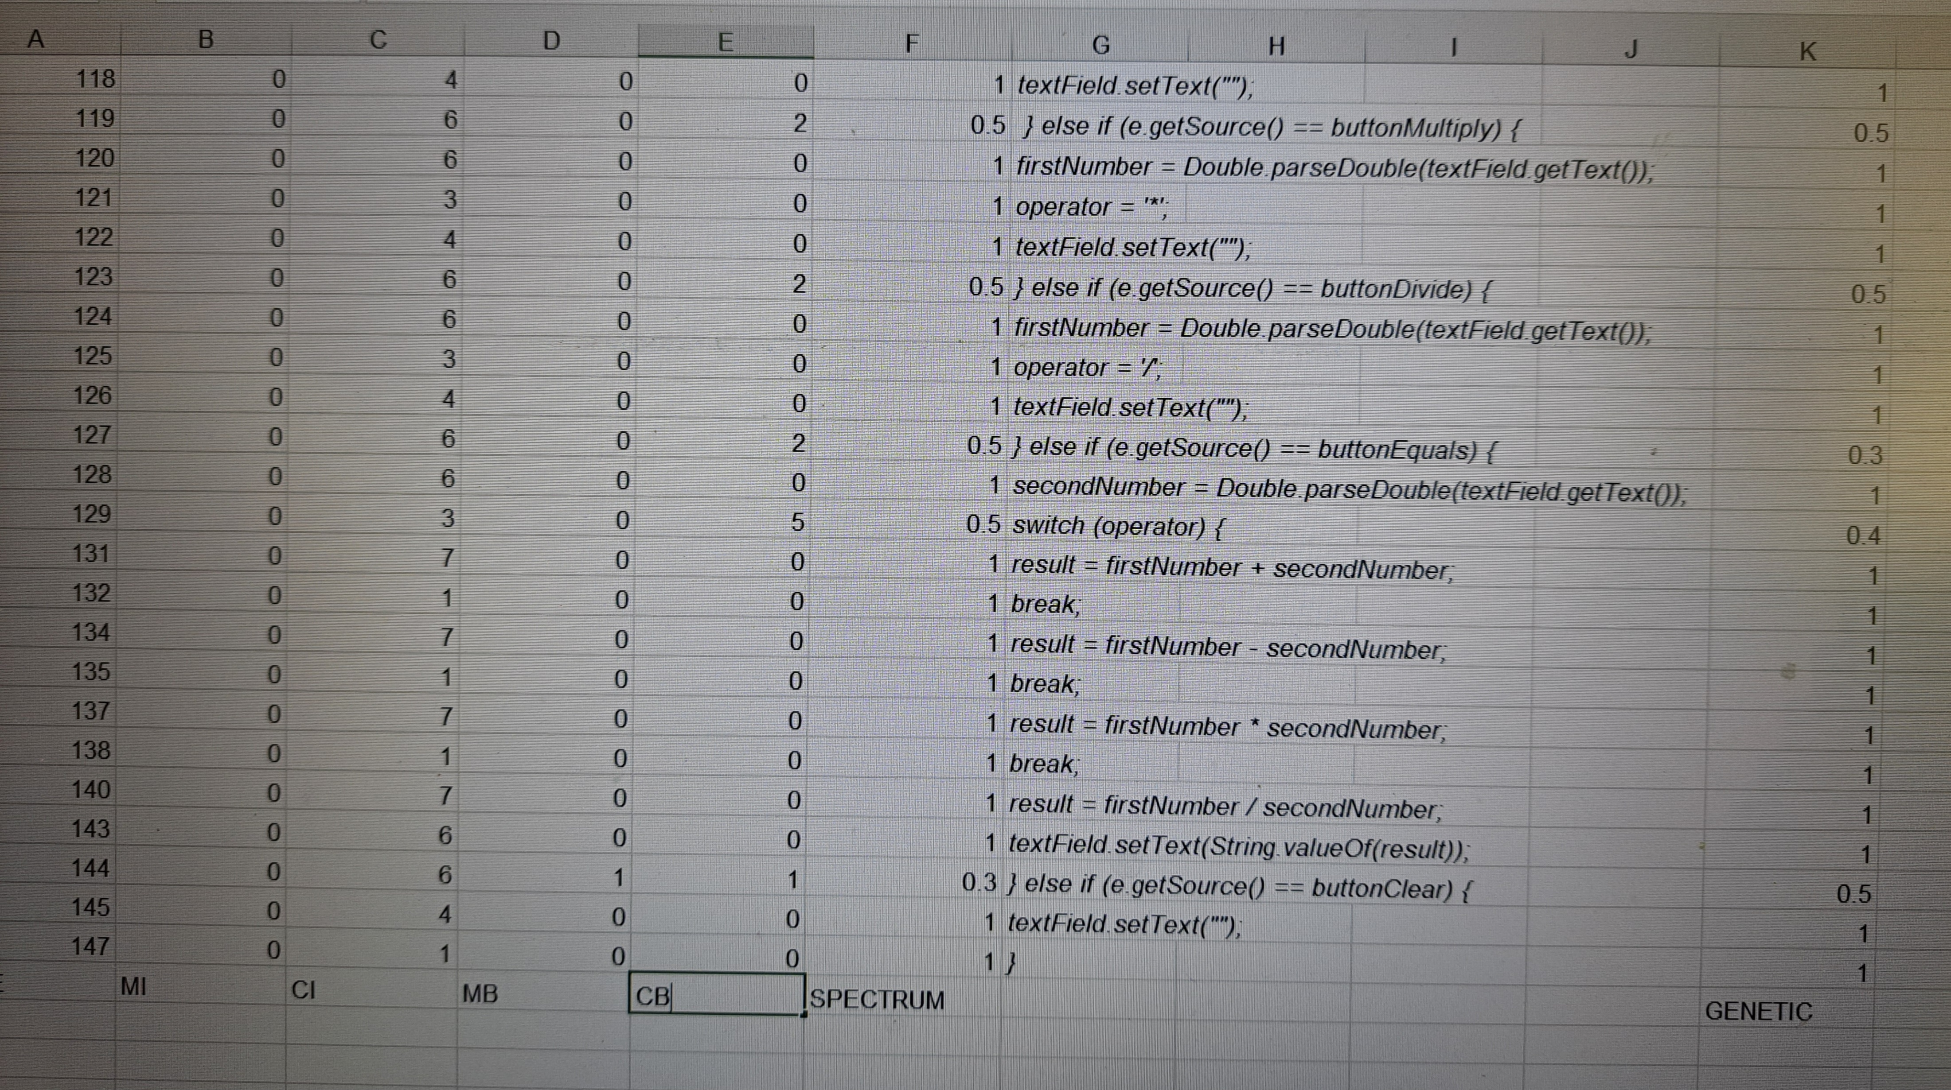
Suspiciousness Report

Slide 17
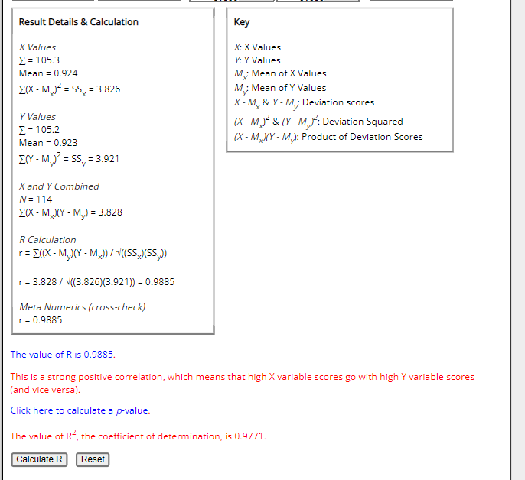
Suspiciousness Report

Slide 18
Limitations of my project
Lack of data.(Due to some laptop configuration problem - test repositories weren't working on my laptop)
Complexity of code.(Complexity of code is an important factor when writing test cases on your own. To properly analyze the code, it should not be too complex to the extent that it becomes impossible to write the test cases on your own)

Slide 19
Thank you

